Slide 1




Human Face Recognition
Track Name: Manufacturing (track-5-j-k-lakshami)
Team Name: DAM Coders
Team Members: Mansi Desai
Devashree Dhagat
Ami Mevada

Slide 2
Problem Statement: Human Face Recognition by using Computer Vision(Deep Learning)
Facial recognition system is a technology capable of matching a human faces from a digital image or a video frame against a database of faces, typically employed to authenticate users through ID verification services, works by propointing and measuring facial features from given image.
Face detection and recognition is an artificial intelligence(AI) based computer technology used to find and identify human faces in digital images.
In face detection and face recognition applications, computer vision plays a vital role.

Slide 3
Introduction:
Facial recognition is a way of identifying or confirming an individual’s identity using their face.
In this project, we have detected the presence of a human face and then determined whose face it is and at what time that particular person has arrived.
It can be applied to various fields including security, biometrics, law enforcement, entertainment and personel safety, to provide survelliance and tracking of people in real time.

Slide 4
Proposed Approach:
Now a days, every little day-to-day action are getting need of digitalization. In the field of security or biometrics, etc. there is a great demand for fast and accurate user identification and authentication.
Automatic recognition of humans is a quite challenging problem which is currently in demand in different fields.
There are some approaches or we can say machine learning algorithms which can solve this problem and that includes deep learning using convolutional neural networks(CNN), using support vector machines(SVM), Cascade Classifier, etc.

Slide 5
Proposed Approach:
Now a days, every little day-to-day action are getting need of digitalization. In the field of security or biometrics, etc. there is a great demand for fast and accurate user identification and authentication.
Automatic recognition of humans is a quite challenging problem which is currently in demand in different fields.
There are some approaches or we can say machine learning algorithms which can solve this problem and that includes deep learning using convolutional neural networks(CNN), using support vector machines(SVM), Cascade Classifier, etc.

Slide 6
Why you should choose our Solution:
In this project, we have imported libraries like numpy, opencv, face_recognition, os, and datetime.
In todays world it is very necessary that you requires some security, proper validation, authentication and identification.
So in our project we are supposed to do detect faces and identify to the user and can easily recognize the human faces.
In today’s busy world, we want everything to be done fastly, hence by our project, attendance of the students or the employee in the company can be done efficiently and fastly.

Slide 7
Limitations:
In facial recognition system which we have done in this project, it may have quite quality issue of the image.
It can be expensive.
There can be privacy concerns related to facial recognition.
It takes huge storage requirements.

Slide 8
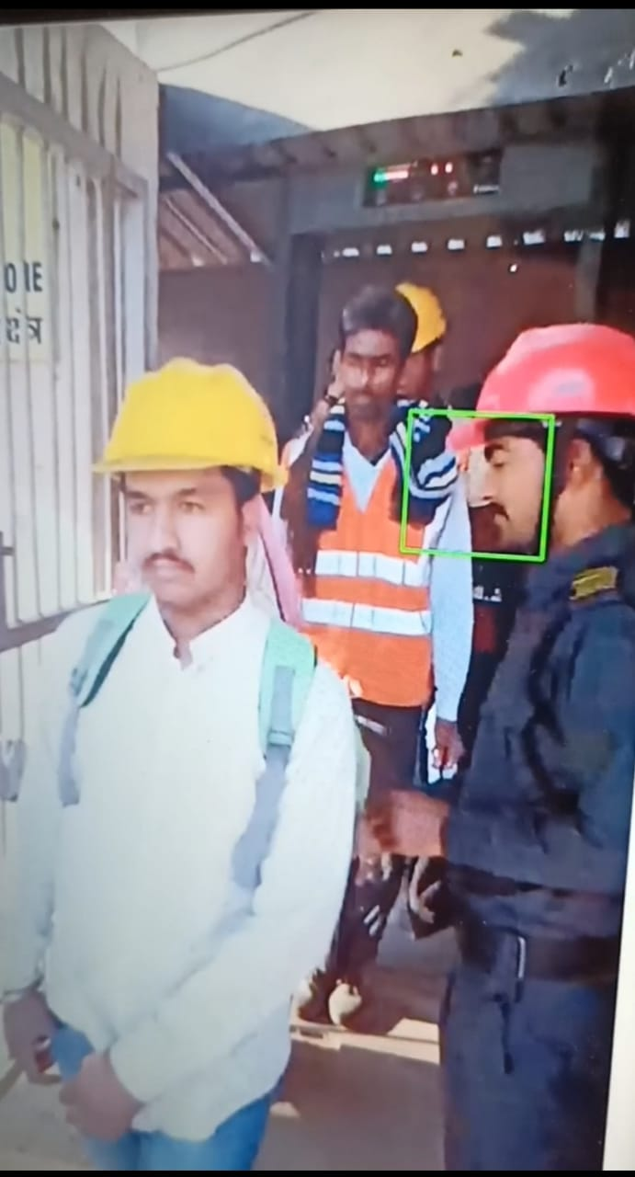
Demonstration of the project:

Slide 9
Thank you

